Slide 1
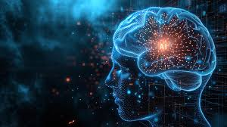
EEG Eye Site Project DEEPEGAZE CLASSIFIER
Subtitle: Eye State Detection Using EEG Signals
Presented by: NEENU P R
Date: 22/05/2025

Slide 2
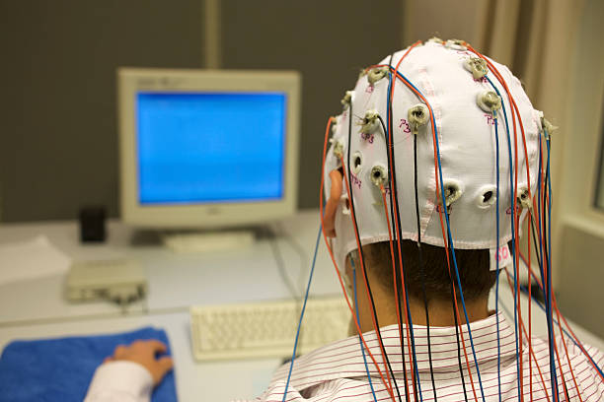
INTRODUCTION
Project Goal: Classify eye state (open or closed) using EEG signals.
Build systems for real-time drowsiness detection, especially useful for:
Drivers
Pilots
Heavy machine operators
Dataset: EEG Eye State Dataset with signal readings from electrodes.

Slide 3
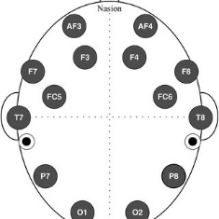
Dataset Description
Source: EEG signals from an Emotive EEG Neuroheadset.
Features: 14 EEG channel values, Class label (1 = Open, 2 = Closed).
Target Variable: Eye state.

Slide 4
Preprocessing Steps
Removed invalid id column.
Filtered classes to include only 1 and 2.
Normalized features using StandardScaler.
Converted class labels to binary (0 = Open, 1 = Closed).
Split data: 80% train, 20% test.

Slide 5
Machine Learning Models Used
Logistic Regression
K-Nearest Neighbors
Decision Tree
Random Forest
Support Vector Machine (Linear Kernel)
Naive Bayes
Gradient Boosting

Slide 6
Model Evaluation Metrics
Accuracy Score
ROC-AUC Score
Confusion Matrix
ROC Curve

Slide 7
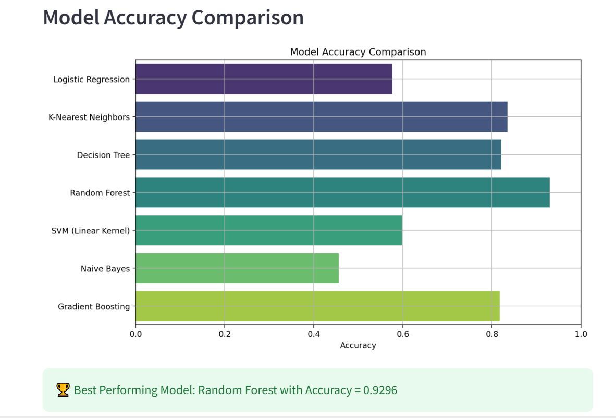
Accuracy Comparison
HIGHEST PERFORMING MODEL : RANDOM FOREST
BEST ACCURACY: 0.9296

Slide 8
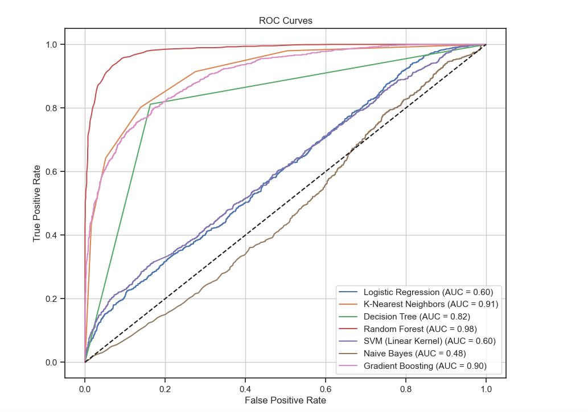
ROC Curve Example
ROC Curve interpretation
AUC Score shown

Slide 9
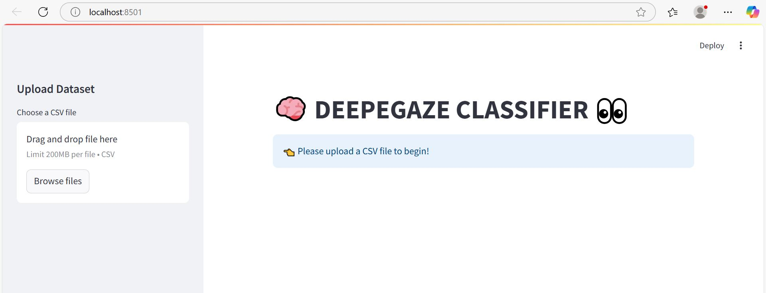
Streamlit App Demo
Features:
Upload CSV
Model selection from sidebar
Visualization: Confusion matrix, ROC curve

Slide 10
Example Use Case: Drowsiness Detection in Drivers
Falling asleep while driving causes thousands of accidents every year. Traditional methods to detect drowsiness (like eye-tracking cameras) may not work in poor lighting or with certain eye conditions.
EEG-Based Solution:
Electroencephalogram (EEG) devices can detect brainwave patterns associated with closed or drowsy eye states, even when a camera can't see the eyes properly.
we use machine learning to:
Learn patterns in the EEG data that correlate with open or closed eyes.
Automatically generalize to new EEG readings (real-time predictions).
Achieve high accuracy and reliability, even with noisy or variable signals.

Slide 11
Outcome of the Project
Using ML models (like Random Forest or Gradient Boosting), we can:
Accurately classify the eye state (open/closed) based on brainwave data.
Build systems for real-time drowsiness detection, especially useful for:
Drivers
Pilots
Heavy machine operators

Slide 12
THANK YOU

